Slide 2

W h at is o r gan ization ???
Derived from the Greek word “organon”,
As we know ‘organ’ - and it means a compartment for a particular job.
An organization is a social group which distributes tasks for a collective goal.

Slide 3

Effectiveness and Efficiency
Efficiency:
Takes into account the amount of resources used to produce the desired output.
Effectiveness:
The degree to which objectives & goals are achieved and the extent to which targeted problems are solved.

Slide 4
Organisational Effectiveness
Organizationaleffectiveness is the concept of how effective an organisation is in achieving the outcomes, the organization intends to produce.
The idea of organizationaleffectiveness is especially important for non profit organisations as most people who donate money to non-profit organizations and charities are interested in knowing whether organization is working effectively or not

Slide 5
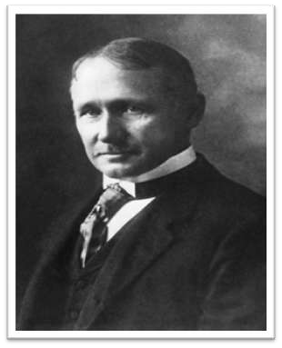

Historical opinions about Organisational effectiveness
Effectiveness was determined by factors such as :-
Production maximization
Cost minimization
Technological excellence
Frederick

Slide 6

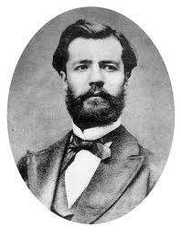
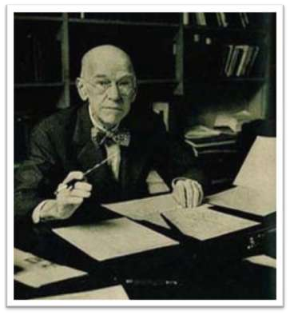
Effectiveness is a function of:-
Clear authority
Discipline within an organization
Productivity
Employee satisfaction
Henri Fayol
Elton Mayo

Slide 7

Effectiveness and Efficiency in Organizations
High
Low Goal Attainment Low Use of Resources | High Goal Attainment Low Use of Resources
Low Goal Attainment High Use of Resources | High Goal Attainment High Use of Resources
EFFICIENCY
Low
Low
High
EFFECTIVENESS

Slide 8
4 APPROACHES TO ORGANIZATION
EFFECTIVENESS…
Goal Attainment Approach
Systems Approach
Strategic Constituencies Approach
Competing Values Approach

Slide 9
1. Goal Attainment Approach
Effectiveness is the ability to excel at one or more output goals.
The Goal Attainment Approach states that an organization’s effectiveness must be appraised in terms of the accomplishment of ends rather than mean.

Slide 10
Contd..
Based on the identification of goals and the achievement of those goals
Goals must be…
Clearly identifiable
Consensual
Measurable
Time-bound

Slide 11
2. System Approach
Here end goals are not ignored; but they are only one element in a more complex set of criteria.
Systems models emphasize criteria that will increase the long term survival of the organization such as –
Its ability to acquire resources, maintain itself internally as a social organism & interact its external successfully with environment.
So, this approach focuses not so much.

Slide 12
3. Strategic Constituencies approach
Effectiveness is the ability to satisfy multiple strategic constituencies both within and outside the organization.
An effective organization is one that satisfies the demands of those constituencies in its environment from whom it requires support for its continued existence.
It seeks to appease only those in the environment who can threaten the organization's survival.

Slide 13
4. Competing values approach
The Competing Values Approach is the criteria you value and use in assessing an organizations effectiveness.

Slide 14
Comparison of 04 approaches
APPROACH | DEFINITION | WHEN USEFUL
Goal Attainment | An organization is effective to the extent that it accomplishes its stated goals. | The approach is preferred when goals are clear, time bound and measureable.
Systems | It acquires needed resources. | A clear connection exists between inputs and outputs.
Strategic Constituencies | Strategic Constituencies are at least minimally satisfied. | Constituencies have powerful influence on the organization, and it must respond to demands.
Competing Values | The emphasis of the organization in the four major areas matches constituent preferences. | The organization is unclear about its own emphases, or changes in criteria over time are of interest.

Slide 15
Q & A Session

